Slide 1
React JS
Prepared by: Vijaya Tiple

Slide 2
State and Props in ReactJS
Props are similar to arguments for pure functions argument. Props of component are passed from parent component which invokes component.
Props in a component cannot be modified(Immutable).
That's how our component receives the props we pass into it. Once there, we can access them in our JSX by using this.props.NameOfProp as follows:
<p>{ this.props.text }</p>
State - Component state can be modified over time in response to user actions, network responses, and anything.
We have to implement class-based components by extending React.Component to get state features. Add a class constructor to add initial state.
Below is a simple example which changes its state every time for user button click.

Slide 3
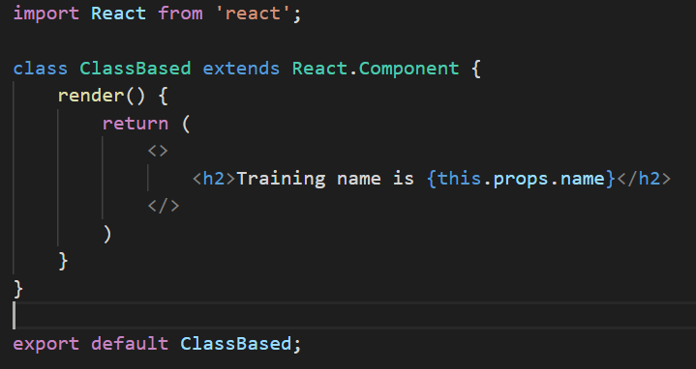
Props in class component

Slide 4
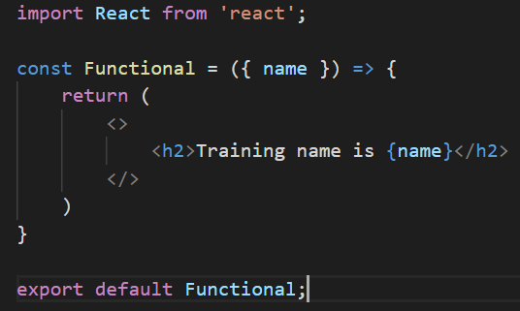
Props in functional component

Slide 5
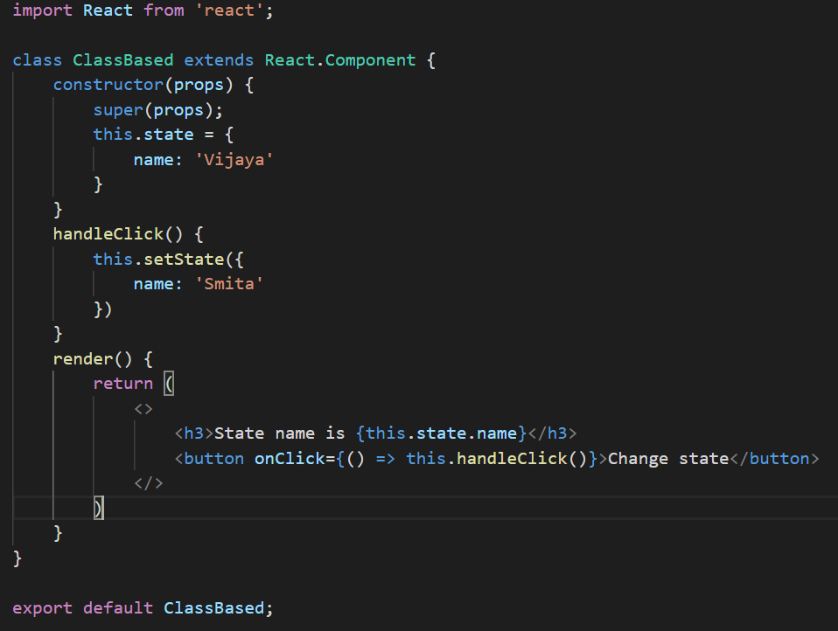
State in class component

Slide 6
Constructor
The constructor is defined in any class based component.
The main use of constructor in react application is defining the initial state of a component.
The constructor can also be used for binding the events in react component.
Super(props) signifies, this component is accepting the props from their parent component.

Slide 7
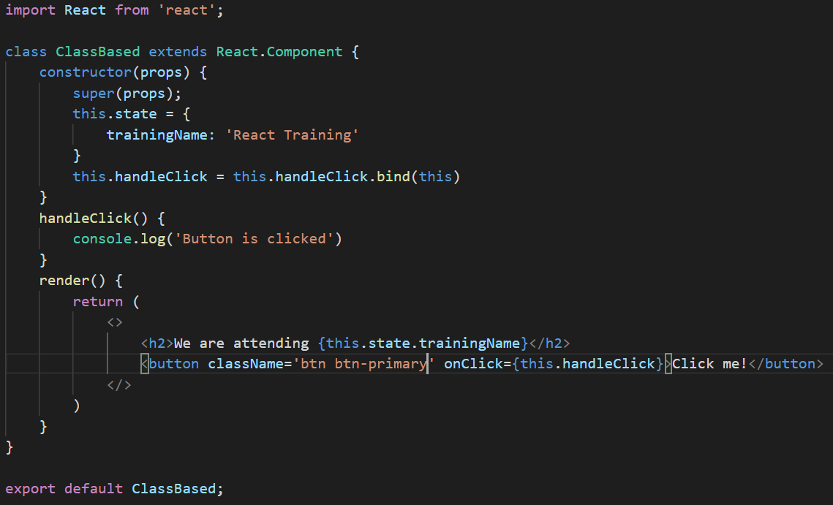
Constructor example

Slide 8
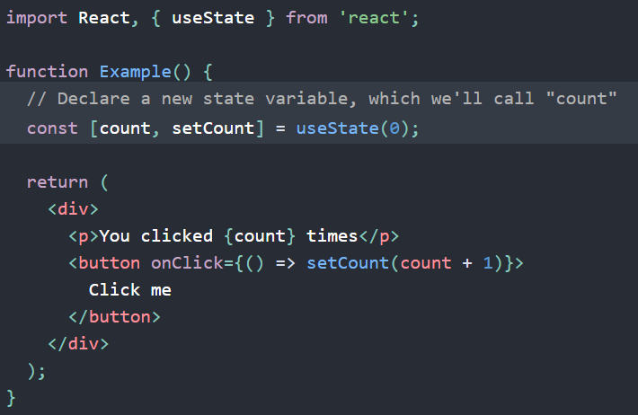
React hooks
Hooks are a new addition in React 16.8. They let you use state and other React features without writing a class.
State hook - useState
It let you use the state inside a functional component from react 16.8

Slide 9
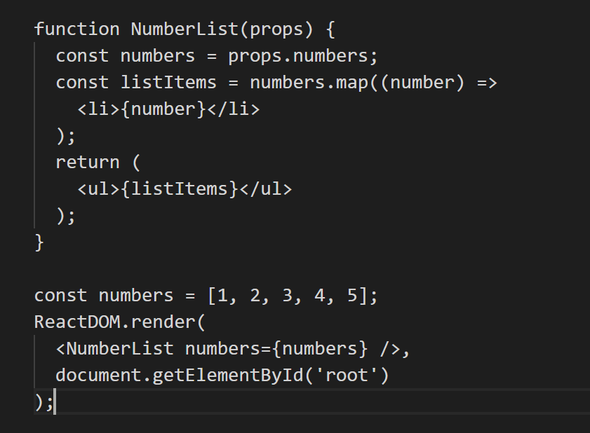
List and Keys
Every React component can be passed a special prop called the key. React uses this key to determine the rendered element's identity. Understanding element identity is critical for performance and minimizing DOM manipulation: for example, if the first element in a list of thousands should no longer be rendered, React needs some way to detect this. Instead of re-rendering thousands of elements, React can simply remove a single DOM node for the first element, which is much more efficient.
Basic List Component
When you run this code, you’ll be given a warning that a key should be provided for list items. A “key” is a special string attribute you need to include when creating lists of elements.

Slide 10
Assignment
Assignment 1: Create a userData set with each user has name, age and gender properties
assignment 2: example to display usertable using props in functional component
Assignment 3: example to display usertable using useState in functional component
Assignment 4: example to display usertable in class bases component using state

Slide 11
Thank you!

